Slide 1

Project Description
Dvora Goncharok
&
Arbel Shifman
Project: “MediGuard”
Risk classification: General, Critical
Task:
Input: Free-text medication-related question (e.g., dosage, interactions, side effects)
Output: Risk Level classification – General (safe) or Critical (dangerous)
Task Type: Binary class text classification (Goal: identify level of potential clinical risk posed by the question)
Data and Evaluation:
Dataset: MedInfo2019-QA-Medications (publicly available on GitHub) Link to the Data Set
Labels: Manual annotation of ~700 examples with new Risk_Level (General / Critical)
Evaluation Metrics: Accuracy, Precision, Recall, F1-score (per class), Confusion Matrix
Evaluation Method: 80/20 Train-Test split, with optional k-fold cross-validation for robustness

Slide 2

Prior Art
Source / Title | Approach / Model | Data | Metrics | Results
Risk of mortality and cardiopulmonary arrest in critical patients presenting to the emergency department using machine learning and natural language processing | XGBoost | 40,218 emergency department (ED) patient questions | AUROC = 0.96 | High accuracy in predicting mortality and cardiac arrest within 24 hours
Identifying the Perceived Severity of Patient-Generated Telemedical Queries Regarding COVID: Developing and Evaluating a Transfer Learning–Based Solution | SBERT contextual embeddings | 11,746 telemedicine queries from eConsult platform | F1 score = 0.917 | Effective at classifying severe vs. non-severe queries
COMPARISON OF PERFORMANCES OF OPEN ACCESS NATURAL LANGUAGE PROCESSING BASED CHATBOT APPLICATIONS IN TRIAGE DECISIONS | GPT-4 | 130,974 high-acuity patient queries categorized as ESI-1 or ESI-2 (Emergency Severity Index) | F1 score = 0.899 | High agreement with emergency medicine experts
Comparison of Diagnostic and Triage Accuracy of Ada Health and WebMD Symptom Checkers, ChatGPT, and Physicians for Patients in an Emergency Department: Clinical Data Analysis Study | ChatGPT 3.5 & 4.0, Ada, WebMD | 40 real patient cases from an emergency department | Top-1 Match: ChatGPT 4.0: 33% Physicians: 47% | ChatGPT models underperformed in diagnostic accuracy compared to physicians
Performance of emergency triage prediction of an open access natural language processing based chatbot application (ChatGPT): A preliminary, scenario-based cross-sectional study | ChatGPT | 50 simulated ED patient scenarios | F1 score = 0.461 Cohen’s kappa = 0.341 | Moderate agreement with specialists; potential for improvement
Human intelligence versus Chat-GPT: who performs better in correctly classifying patients in triage? | ChatGPT | 30 simulated triage case vignettes | Cohen’s kappa = 0.278 | Triage nurses consistently outperformed ChatGPT

Slide 3

Steps and Pipeline
Pipeline Overview:
Input: Free-text medication-related question (e.g., about dosage, side effects, interactions)
Output: Risk level classification – General (safe) or Critical (dangerous)
Task Type: Binary class text classification problem using an NLP pipeline
Preprocessing
Text cleaning: lowercasing, punctuation removal
Manual annotation of ~700 questions with new Risk_Level labels (General / Critical)
Label balancing techniques to address class imbalance (e.g., oversampling Critical)
Feature Representation
TF-IDF vectorization for feature extraction
Critical Similarity feature generation based on TF-IDF cosine similarity
Dimensionality reduction (SVD) to reduce feature space and address high feature-to-sample ratio
Data includes: Question text, existing question type, drug focus, and URL source

Slide 4

Steps and Pipeline
Models to Compare
SMOTE (Synthetic Minority Over-sampling Technique) applied to balance class distribution in training data
Models used:
Logistic Regression
Random Forest
SVM
Gradient Boosting
KNN
SGD with regularization
Evaluation Strategy
Metrics: Accuracy, Precision, Recall, F1-Score (per class), Confusion Matrix
Method: 80/20 Train-Test split, with optional k-fold cross-validation for robustness

Slide 5
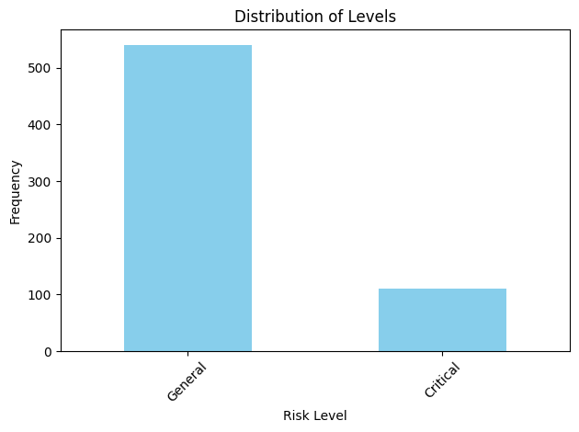
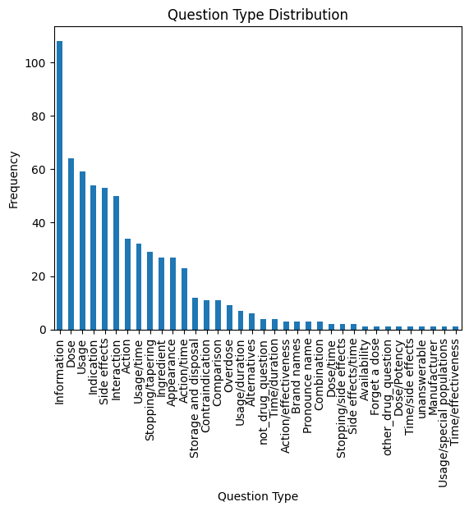

Exploration & Baseline
Dataset:
Question Text + Risk Level Column: General: Questions associated with lower risk. Critical: Questions associated with higher risk that may require immediate attention.
652 questions after cleaning and preprocessing.
Mean question length: 50 +/- 35 words.
Data Imbalance: The dataset is unbalanced, with more questions in the General category than in the Critical category.
SMOTE was used to balance the dataset by generating synthetic examples for the Critical category.
EDA Process:
Text Preprocessing, tokenization and Vectorization:
Text Preprocessing: This step involves cleaning the text by removing irrelevant characters (Stop Words) and formatting issues.
Tokenization: The cleaned text is then split into tokens (words), which are the fundamental units of analysis.
TF-IDF Vectorization: After tokenization, the words are converted into numerical vectors using the TF-IDF technique, which helps capture the importance of each word relative to the entire dataset.
Additional feature engineering was later performed to enrich the data, including the creation of a Critical Similarity feature.

Slide 6
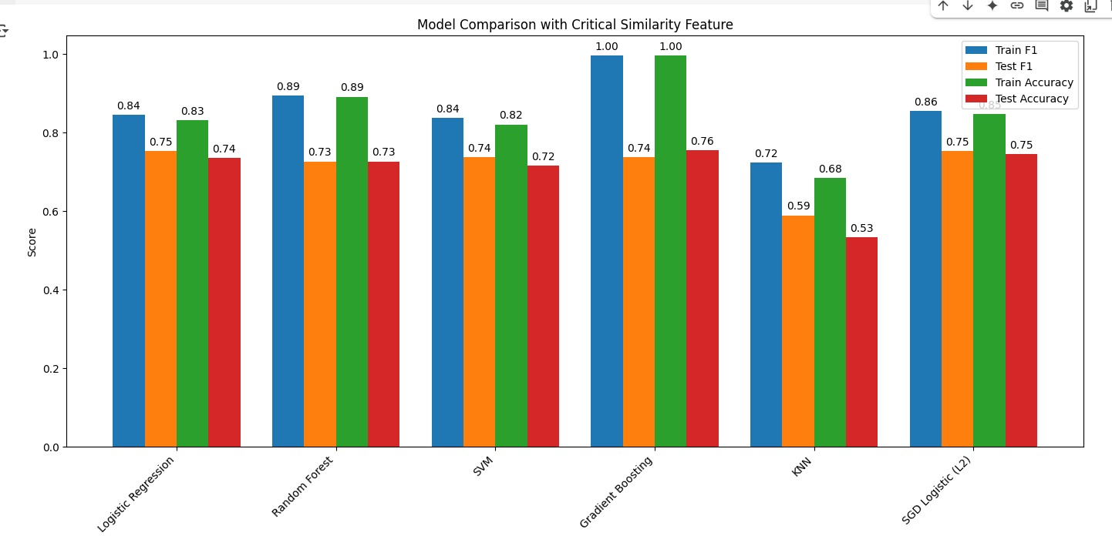

Baseline Model Evaluation Results:
The key metrics used were Accuracy, F1 Score, Precision, and Recall.
Logistic Regression showed the best overall performance with high accuracy and a balanced F1 Score, no overfitting shown.
Random Forest performed well but with slightly lower Recall and slight drop in test performance.
SVM showed stable results without overfitting
KNN showed weaker results with lower accuracy and signs of poor generalization.
Gradient Boosting achieved perfect training results but showed strong overfitting, with lower performance on the test set.
Train vs Test Accuracy: Indicates how well the models generalize.
F1 Score evaluates model performance by factoring both Precision and Recall.

Slide 7


Insights from Data Exploration (EDA)
Data Quality:
Text is of appropriate length, but the dataset is imbalanced (more General questions than Critical).
Challenge:
Difficulty distinguishing between categories.
Solution: SMOTE to balance the dataset.
Text Preprocessing:
TF-IDF was used to vectorize the questions, but the feature-to-sample ratio was high, risking overfitting.
Solution: Dimensionality reduction (SVD) to reduce features.
Feature Engineering:
To enrich the available information, we created a new feature: Critical Similarity.
Steps:
Selected truly critical questions from the original dataset.
Represented questions and critical examples using TF-IDF.
Calculated cosine similarity between each question and the set of critical questions.
Assigned each question a similarity score.
Added the Critical Similarity feature after SVD.

Slide 8

Observations from Critical Similarity:
Most questions had low similarity scores (0–0.1).
A small subset showed higher similarity (≥0.4), indicating strong relation to critical questions.
Baseline Performance:
Modest performance with signs of overfitting (~68%-100% accuracy).
Challenge:
Dataset imbalance, high feature-to-sample ratio, and lack of semantic signals.
Solution:
Applied SMOTE for balancing.
Used SVD for dimensionality reduction.
Enriched vectors with the Critical Similarity feature.
Experimented with ensemble learning techniques.
Conclusion:
Adding the Critical Similarity feature provided the model with valuable semantic hints.
Further improvement could be achieved by expanding the pool of critical examples or incorporating external medical knowledge.

Slide 9
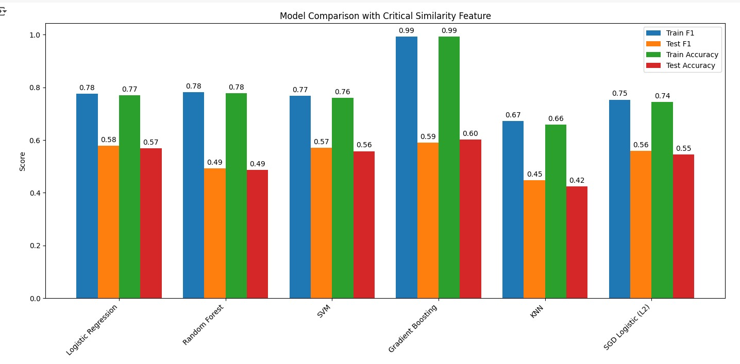
Triangular classification:
Binary vs. Multi-Class Performance:
When switching to binary classification (Critical vs. General), models like logistic regression and SVM achieved more stable results around 75% without signs of overfitting.
In contrast, multi-class classification (Critical, Personal, General) showed significant overfitting and lower performance (~50% accuracy).
Binary classification:

